Slide 1
Distributed Message Queue

Slide 2
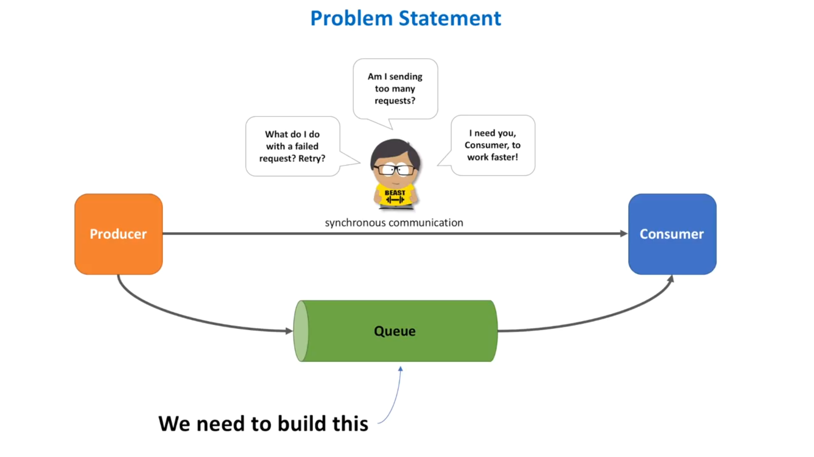

Slide 3
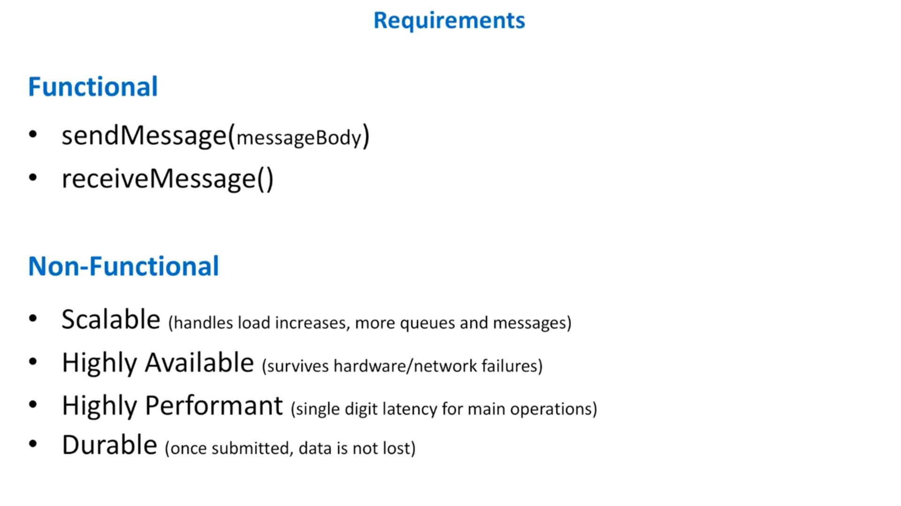

Slide 4
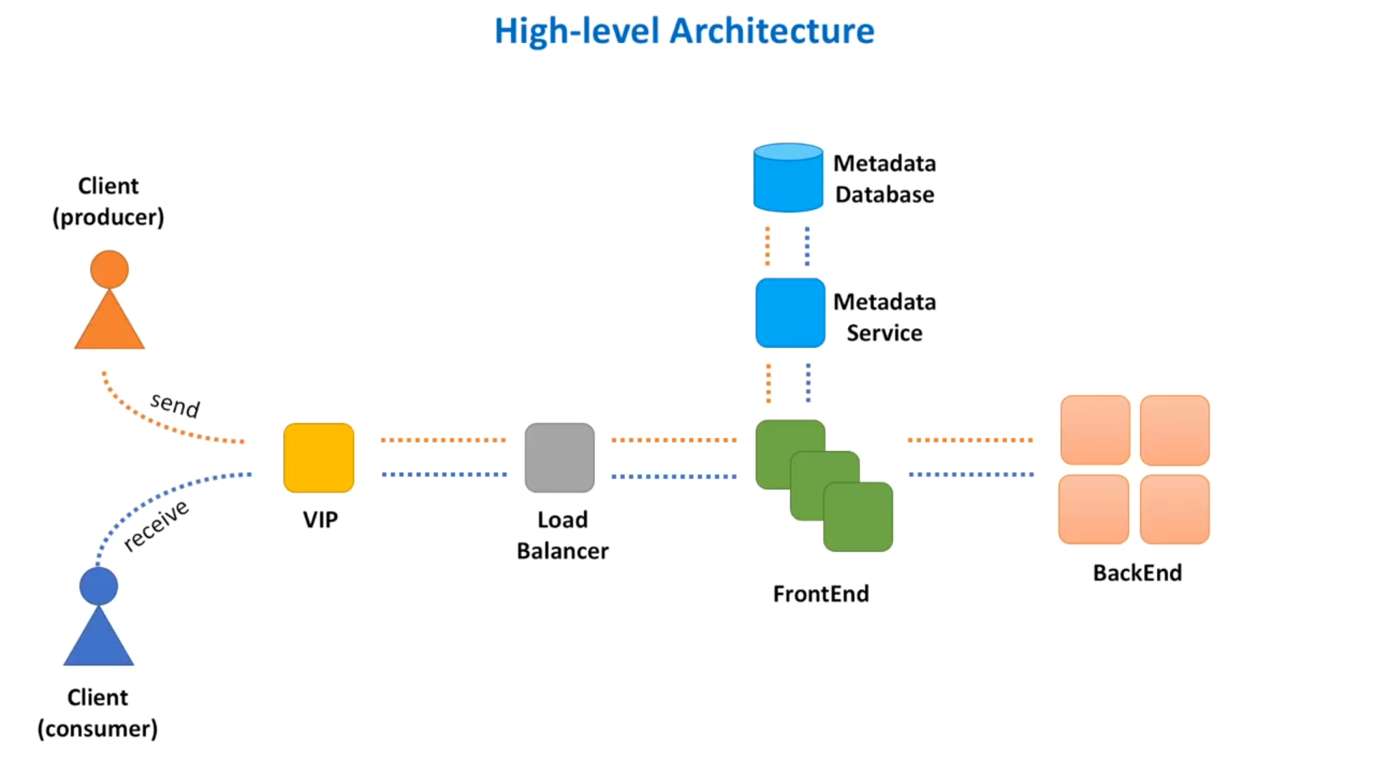

Slide 5
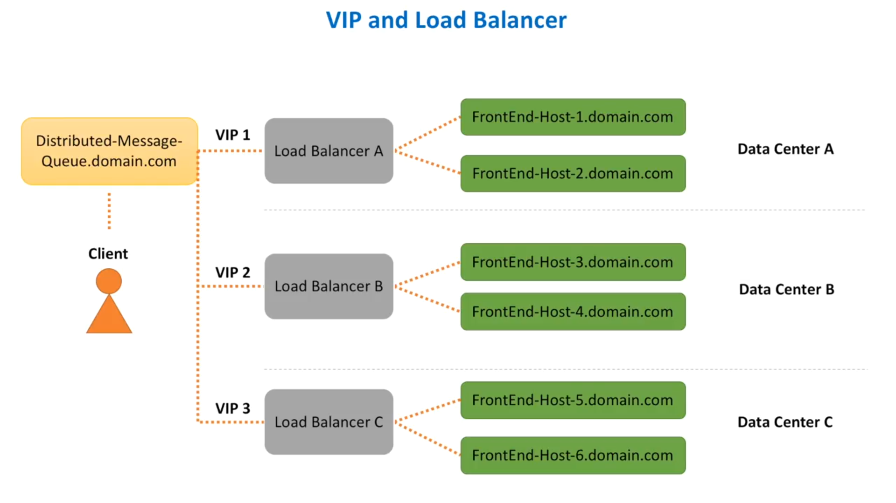

Slide 6
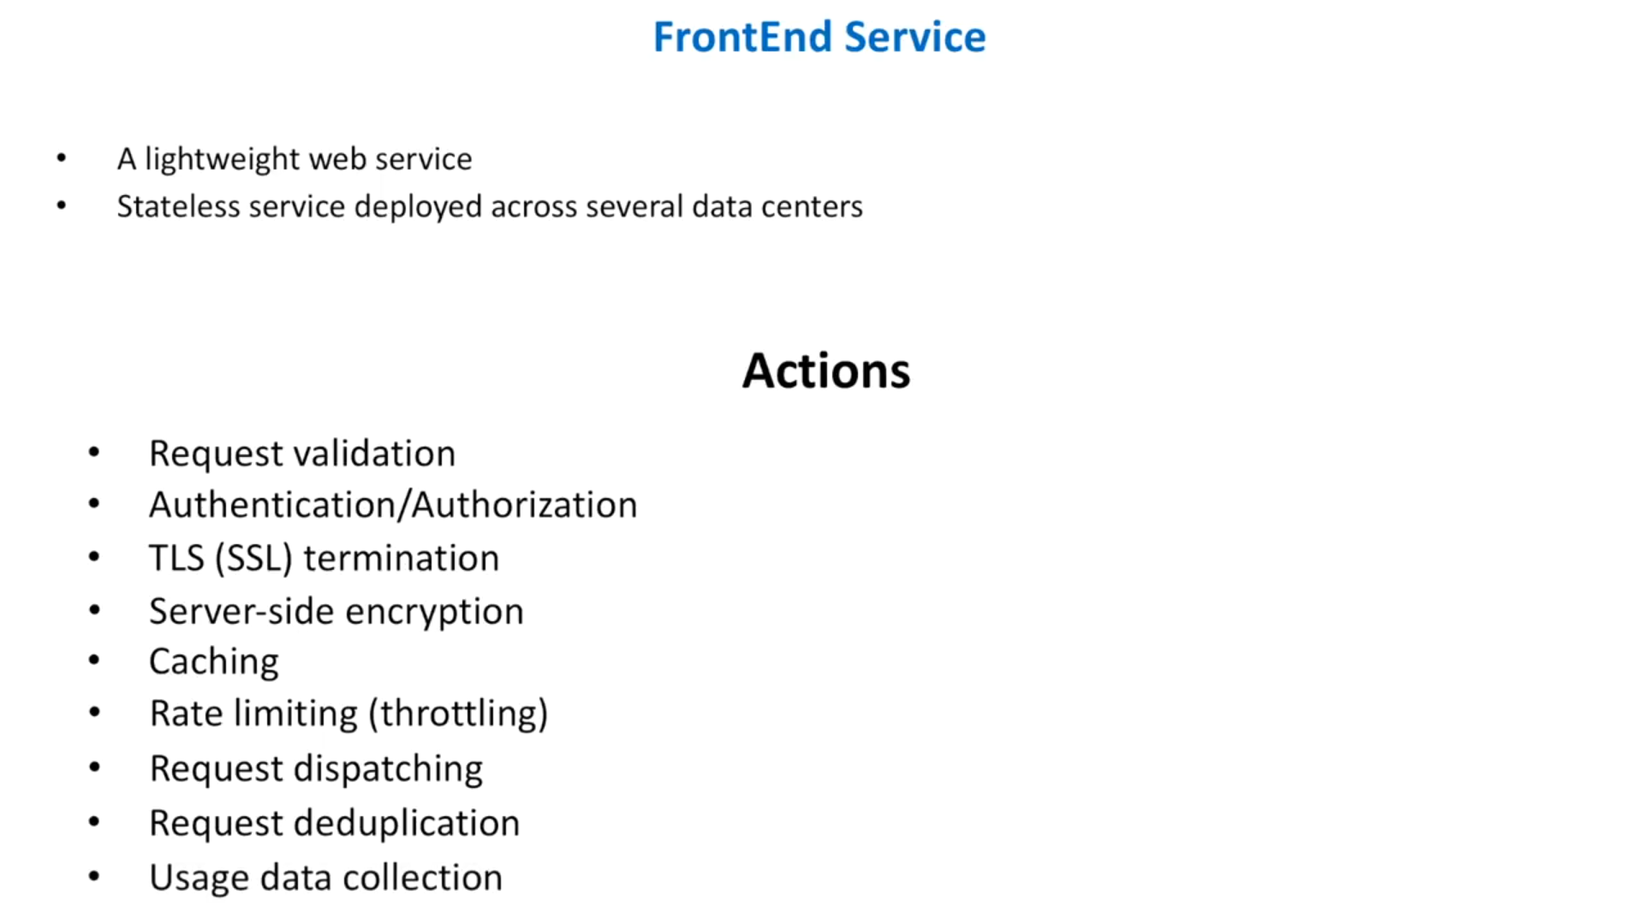
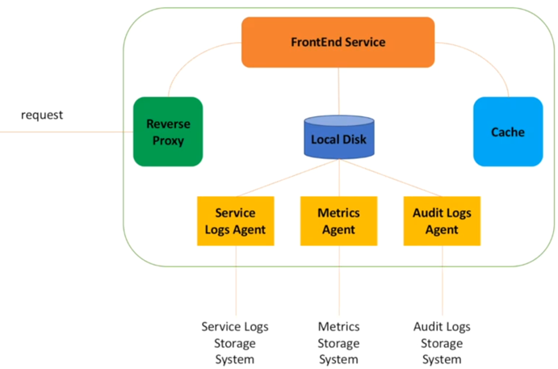

Slide 7
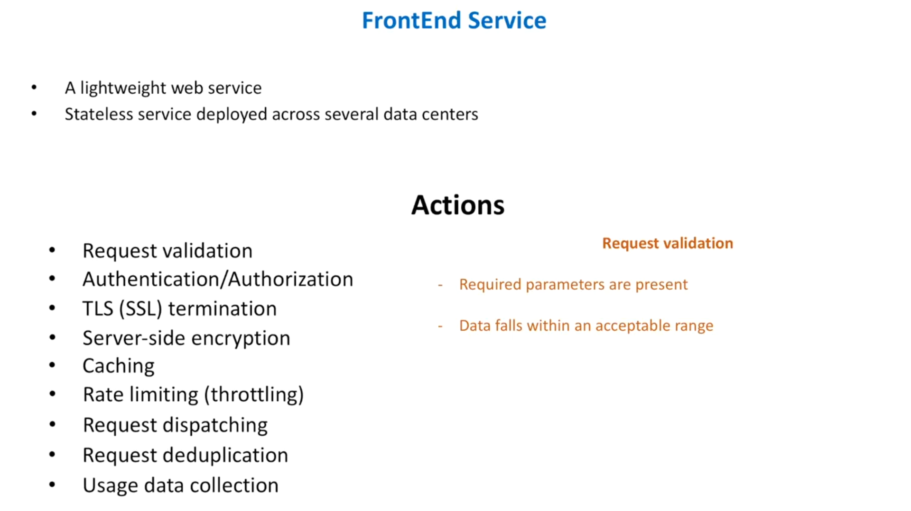
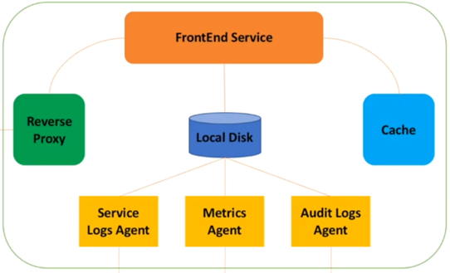

Slide 8
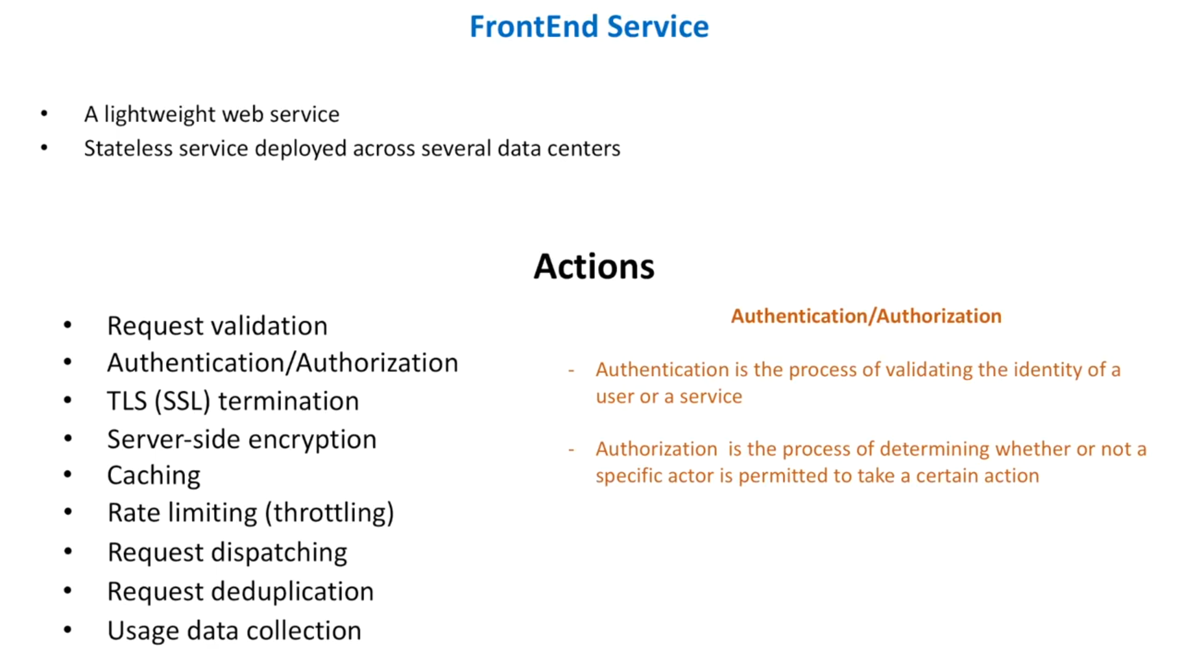

Slide 9
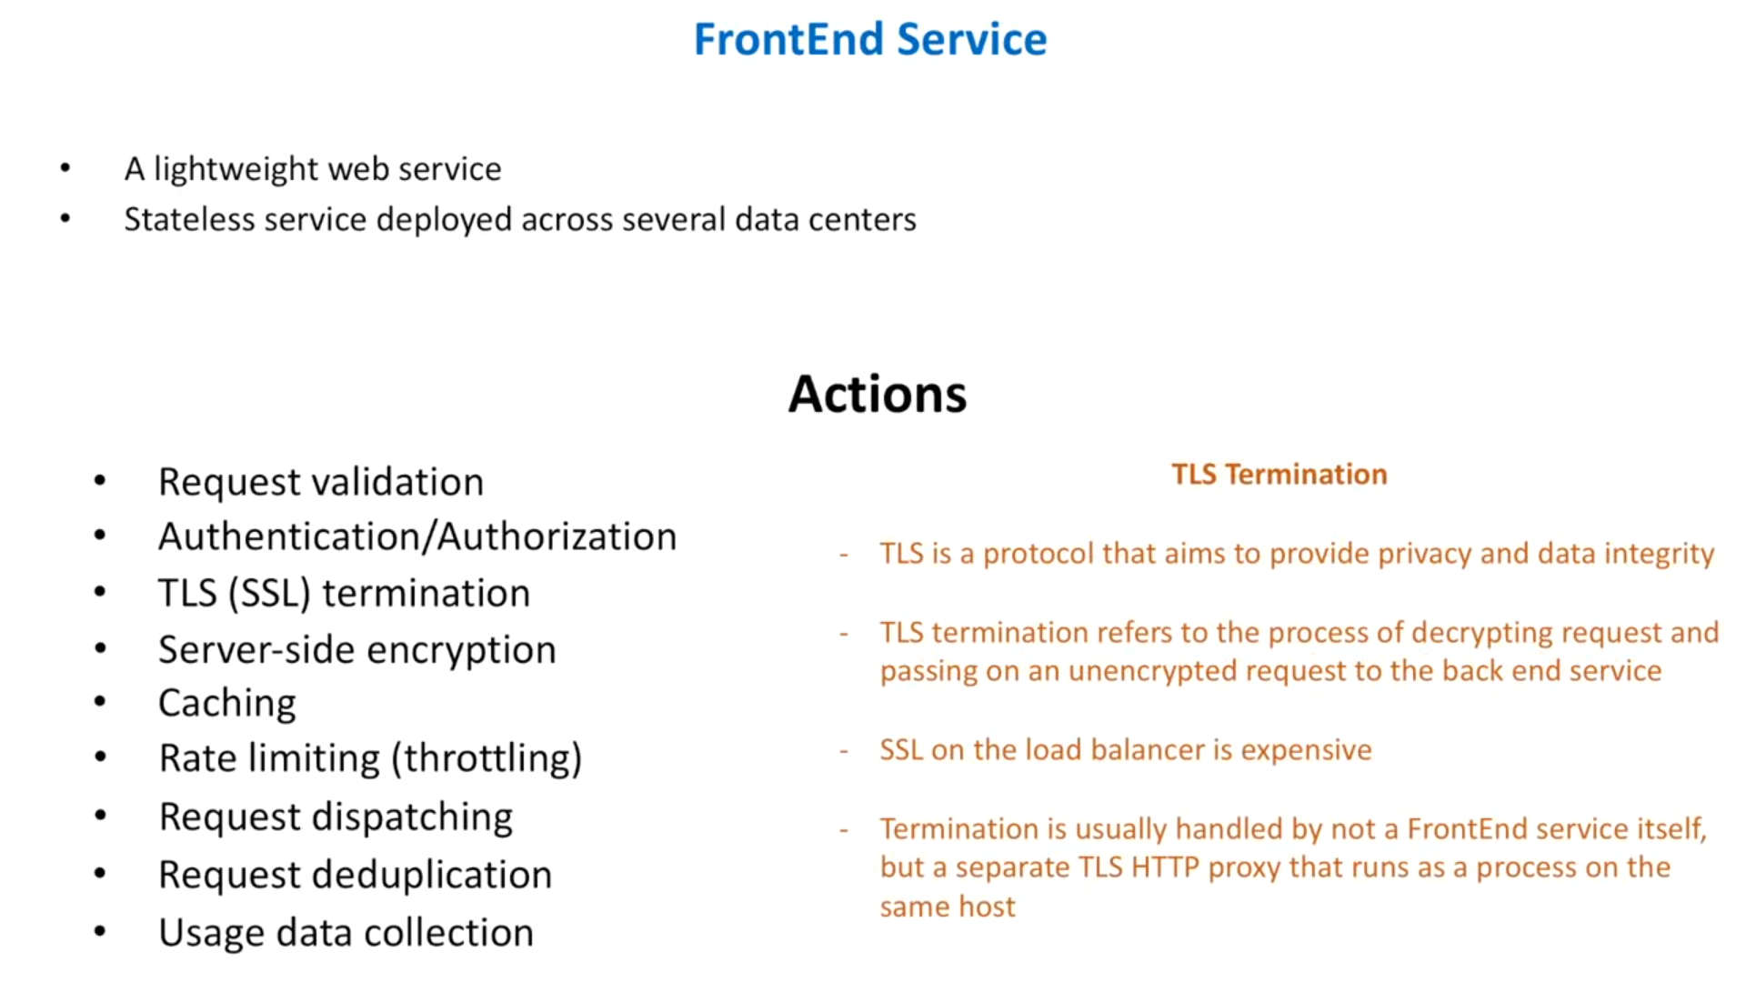

Slide 10
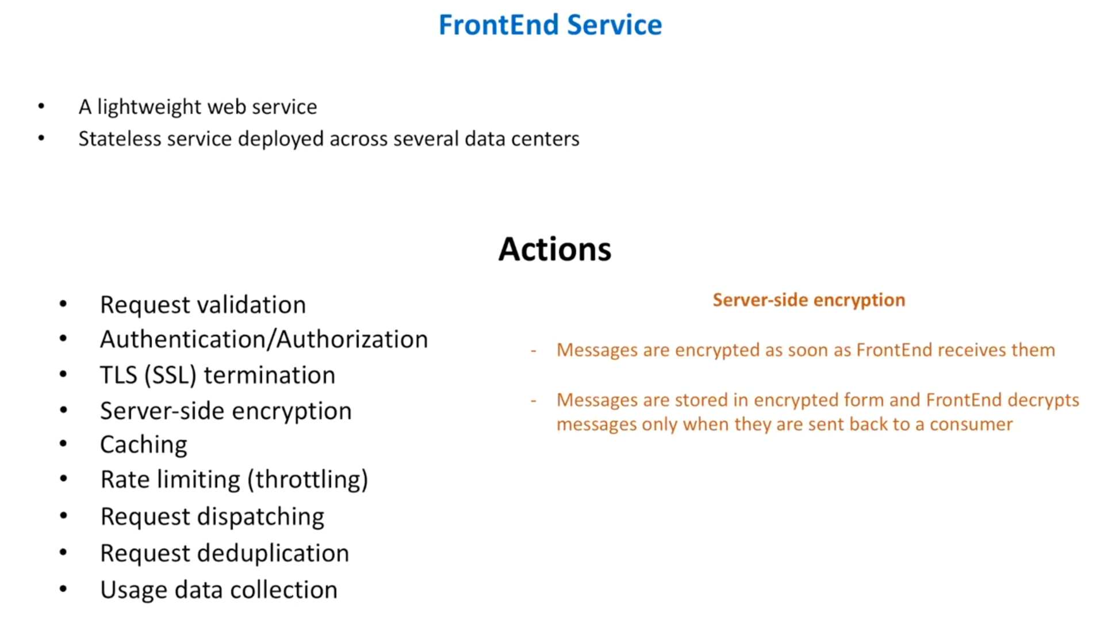

Slide 11
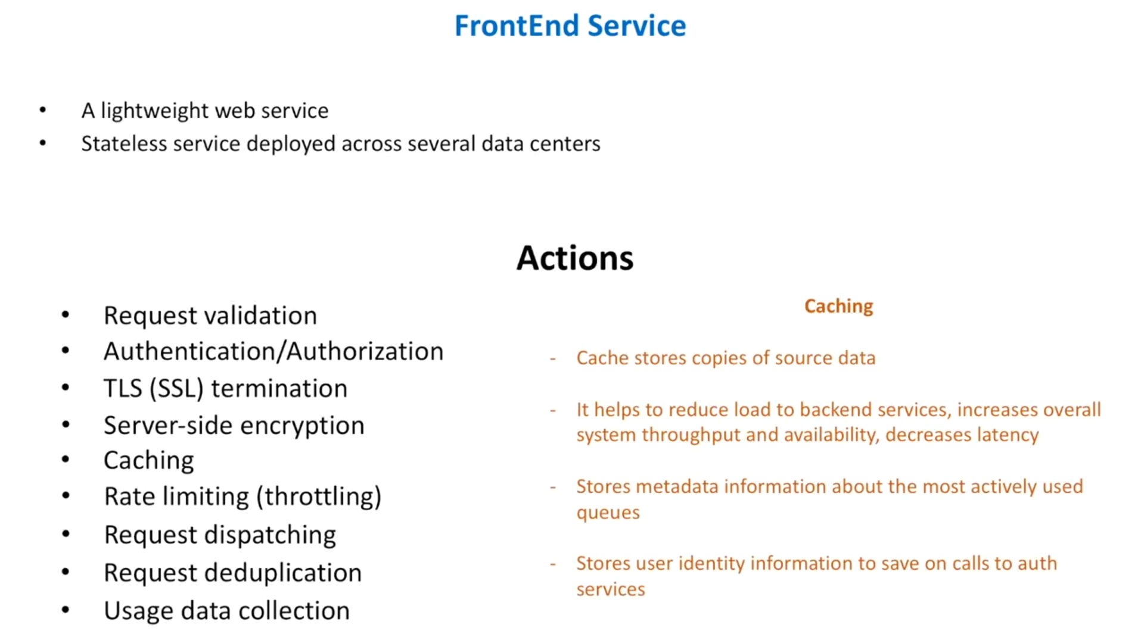

Slide 12
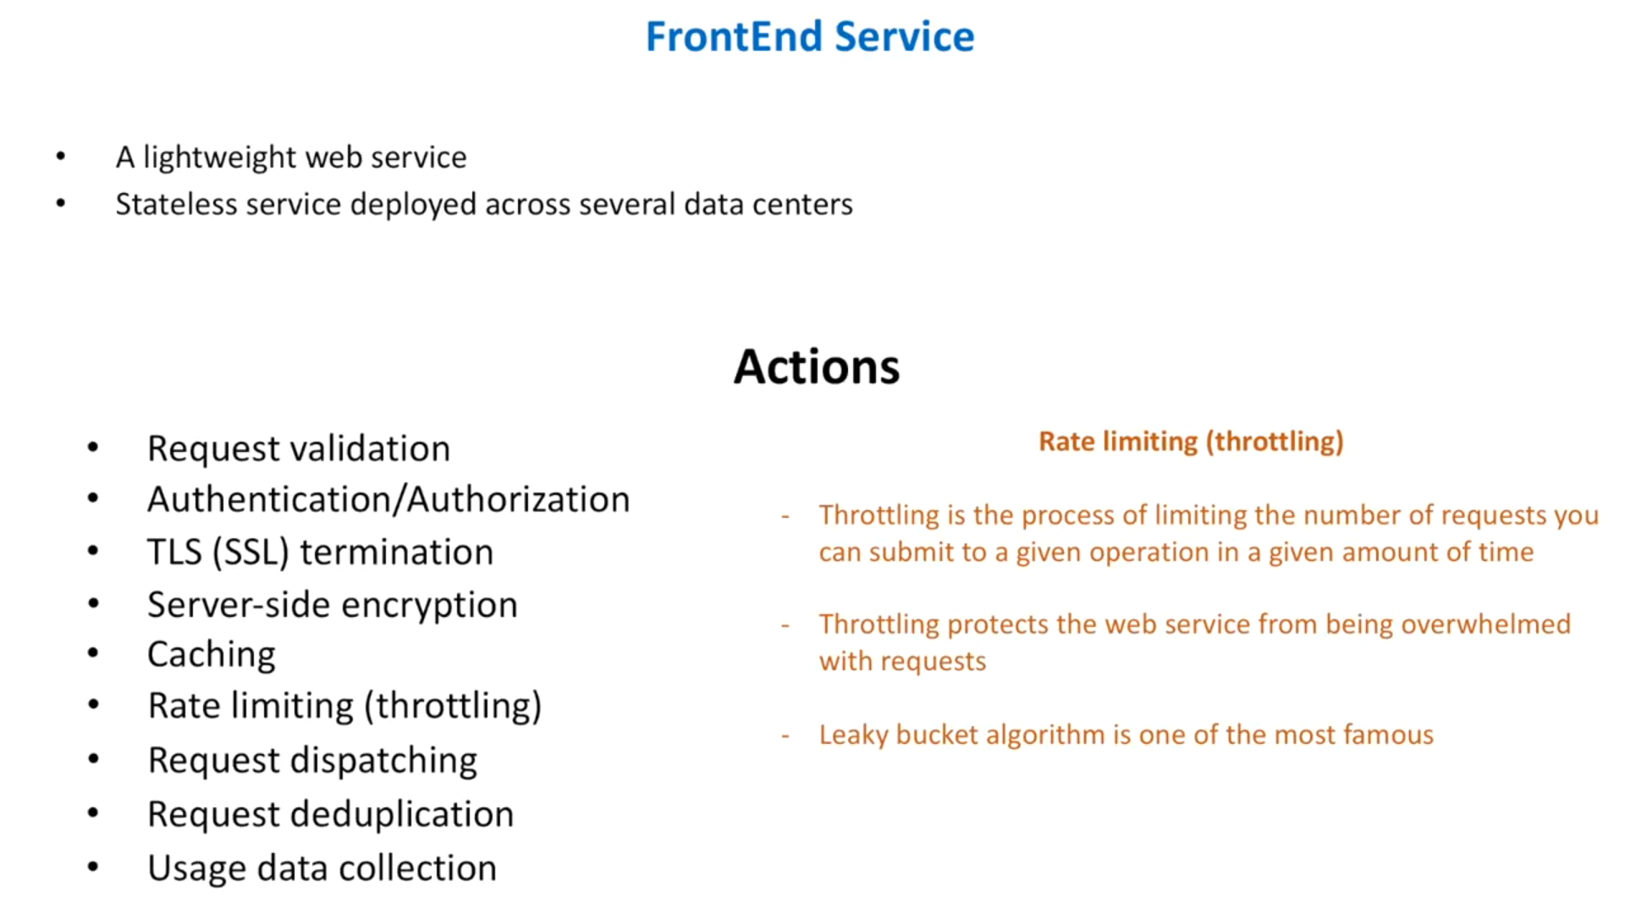

Slide 13
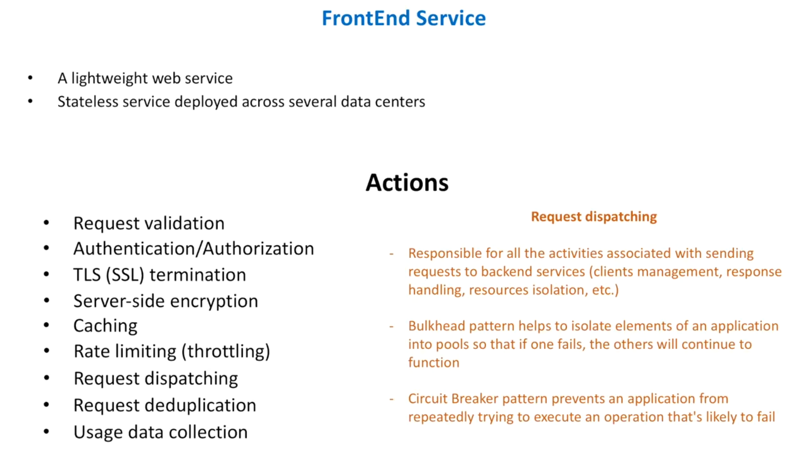

Slide 14
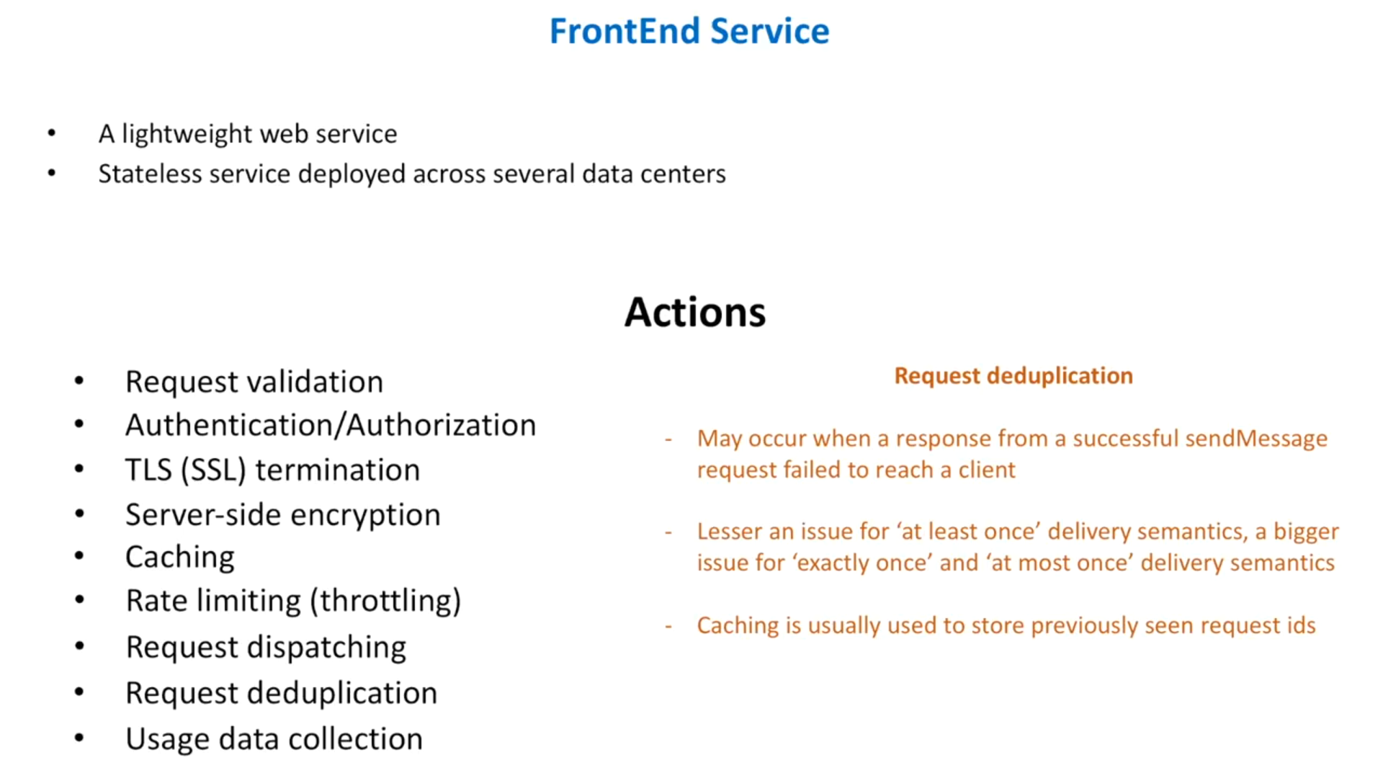

Slide 15
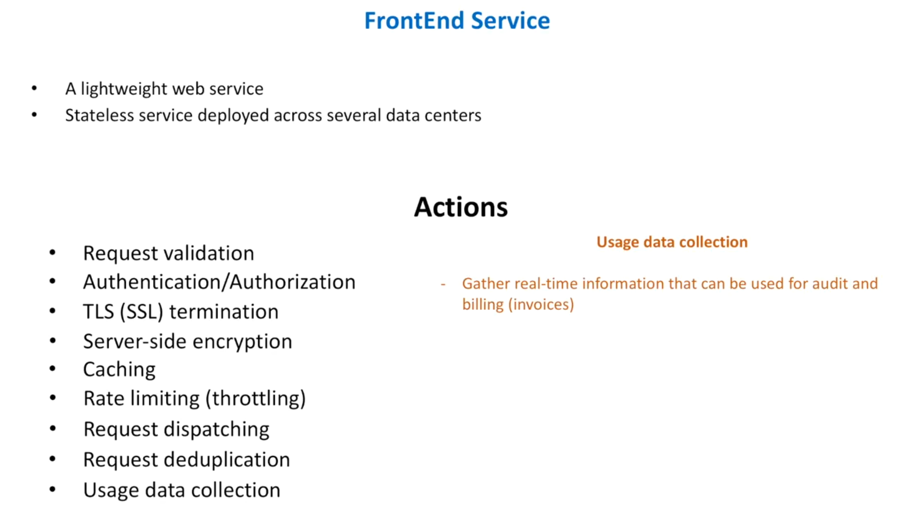

Slide 16
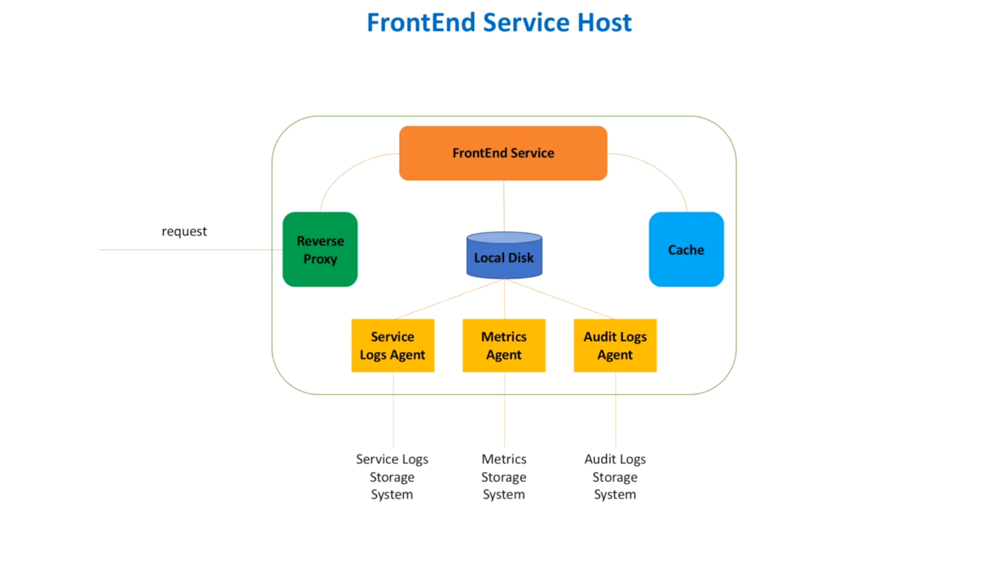

Slide 17
Reverse Proxy - A light weight server responsible for
SSL termination
Requests are decrypted and sent to internal services. Responses are encrypted and sent to clients.
Responsible for response compression. It helps to reduce the bandwidth
Frontend Service -
Reverse proxy passes the request to frontend service.
Front end service calls the metadata service to get the queue information.
To reduce the number of calls made to MS, FS can use a cache.
Cache can be Google guava or our own implementation.
Local Disk - FS writes bunch of different logs into the local disk. Info related to
Service health
Metrics such as number of requests, faults
Audit logs like who and when made requests.
Note : FS only writes log data. But the actual log data processing is done and managed by other components called agents. Agents are responsible to process the logs and transfer them to other systems.

Slide 18
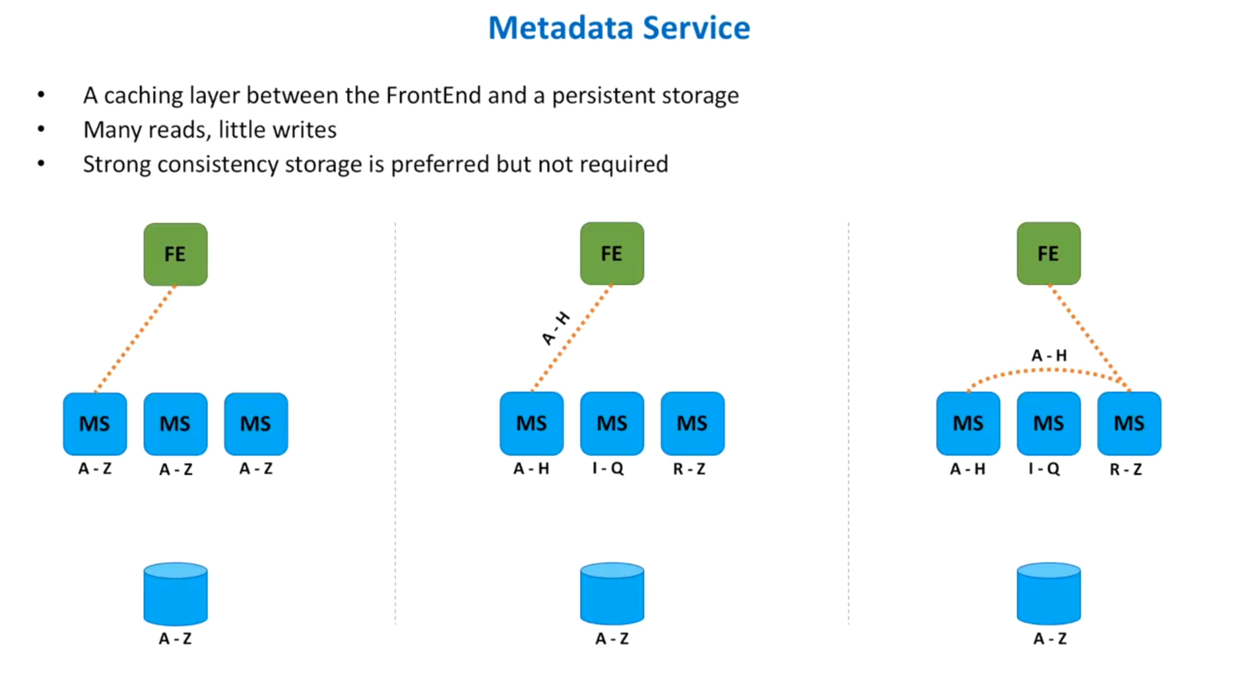
It stores info about queues. Every time a queue is created, we store info about it in database.
as we read very time a msg arrives and write when a new queue is created.

Slide 19
Where and how do we store messages?
Is database an option? Yes it is but not the best one. Because we want a system with high throughput (the amount of material or items passing through a system or process). If we keep a db then the problem changes to designing a db with high throughput.
Is memory an option? Yes.
Is local storage like file system a good option? Yes.
How do we replicate data?
Replicate within a group of hosts.
How does FrontEnd select a backend host to send / retrieve data.
Using Metadata Service

Slide 20
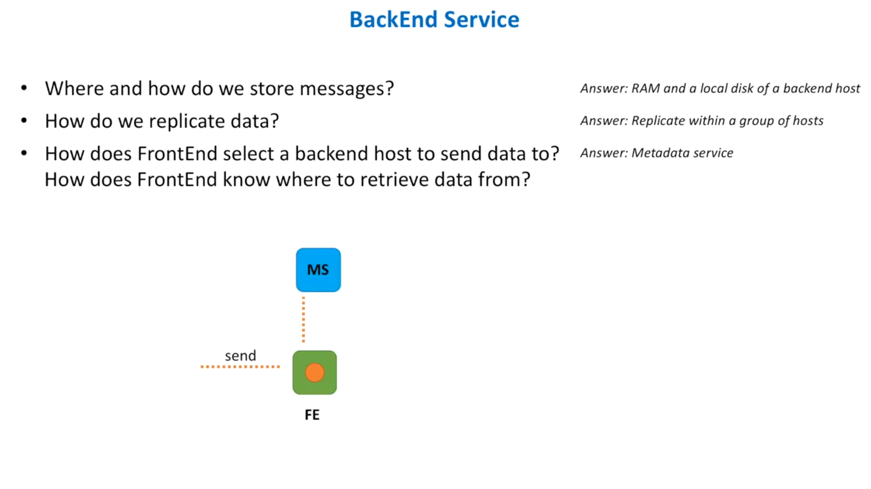
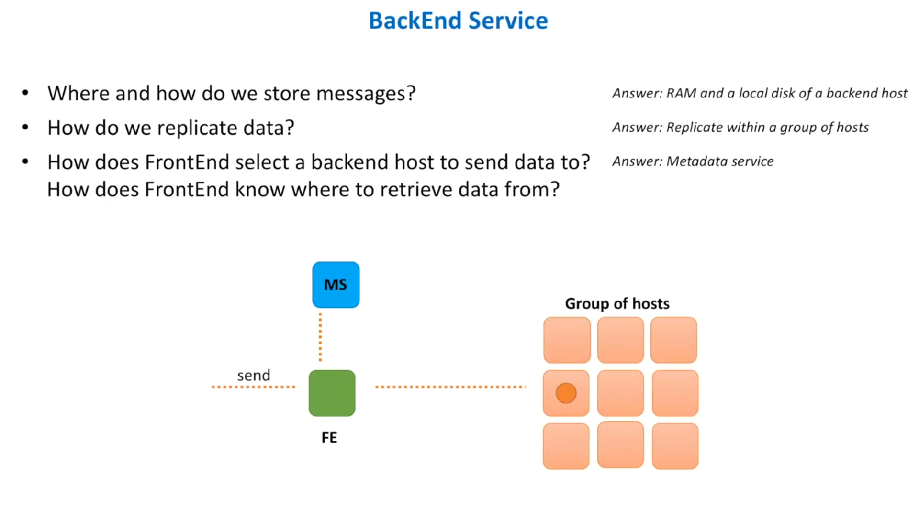
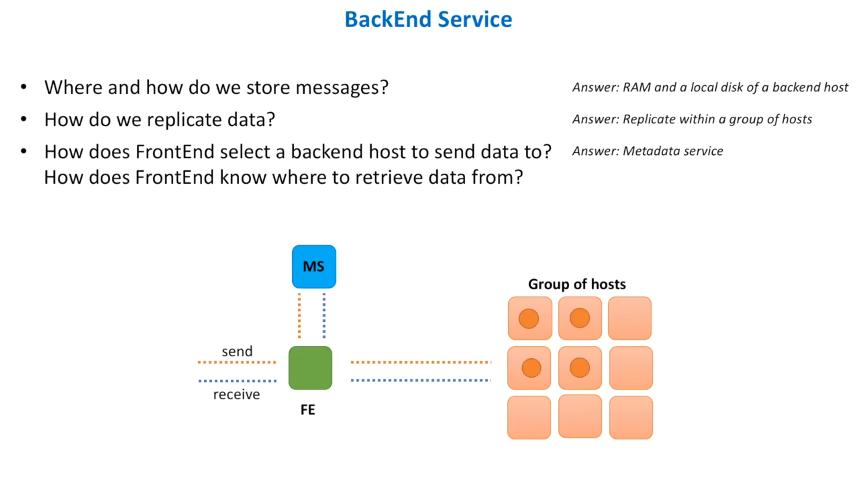
Each queue has a separate cluster
of hosts. This info is stored in MS.
Message comes to a FS.
FS consults with MS to select a
backend host for this queue_id.
Message is sent to a selected
backend host and data is replicated.

Slide 21
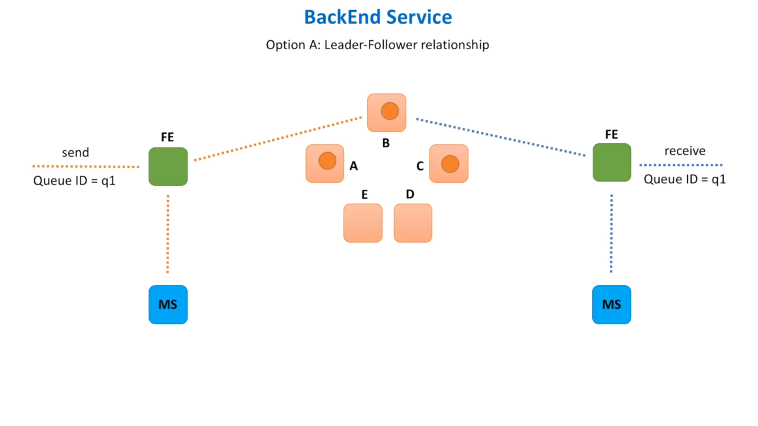
1. Message comes to FS. It consults MS to find the leader for this queue. In this case B.
2. Message is passed to B. B is responsible to replicate the data.
3. Read Request comes to B. B releases the data and is responsible to clean up the data from the replicas.

Slide 22
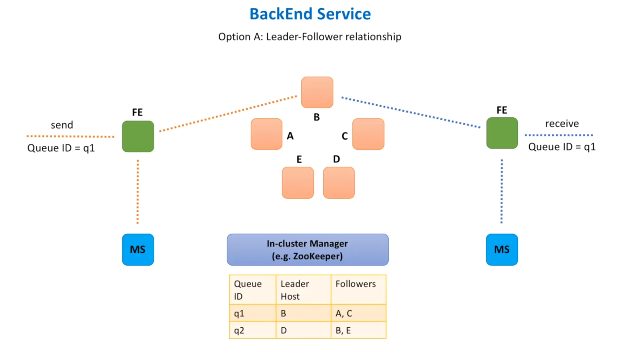

Slide 23
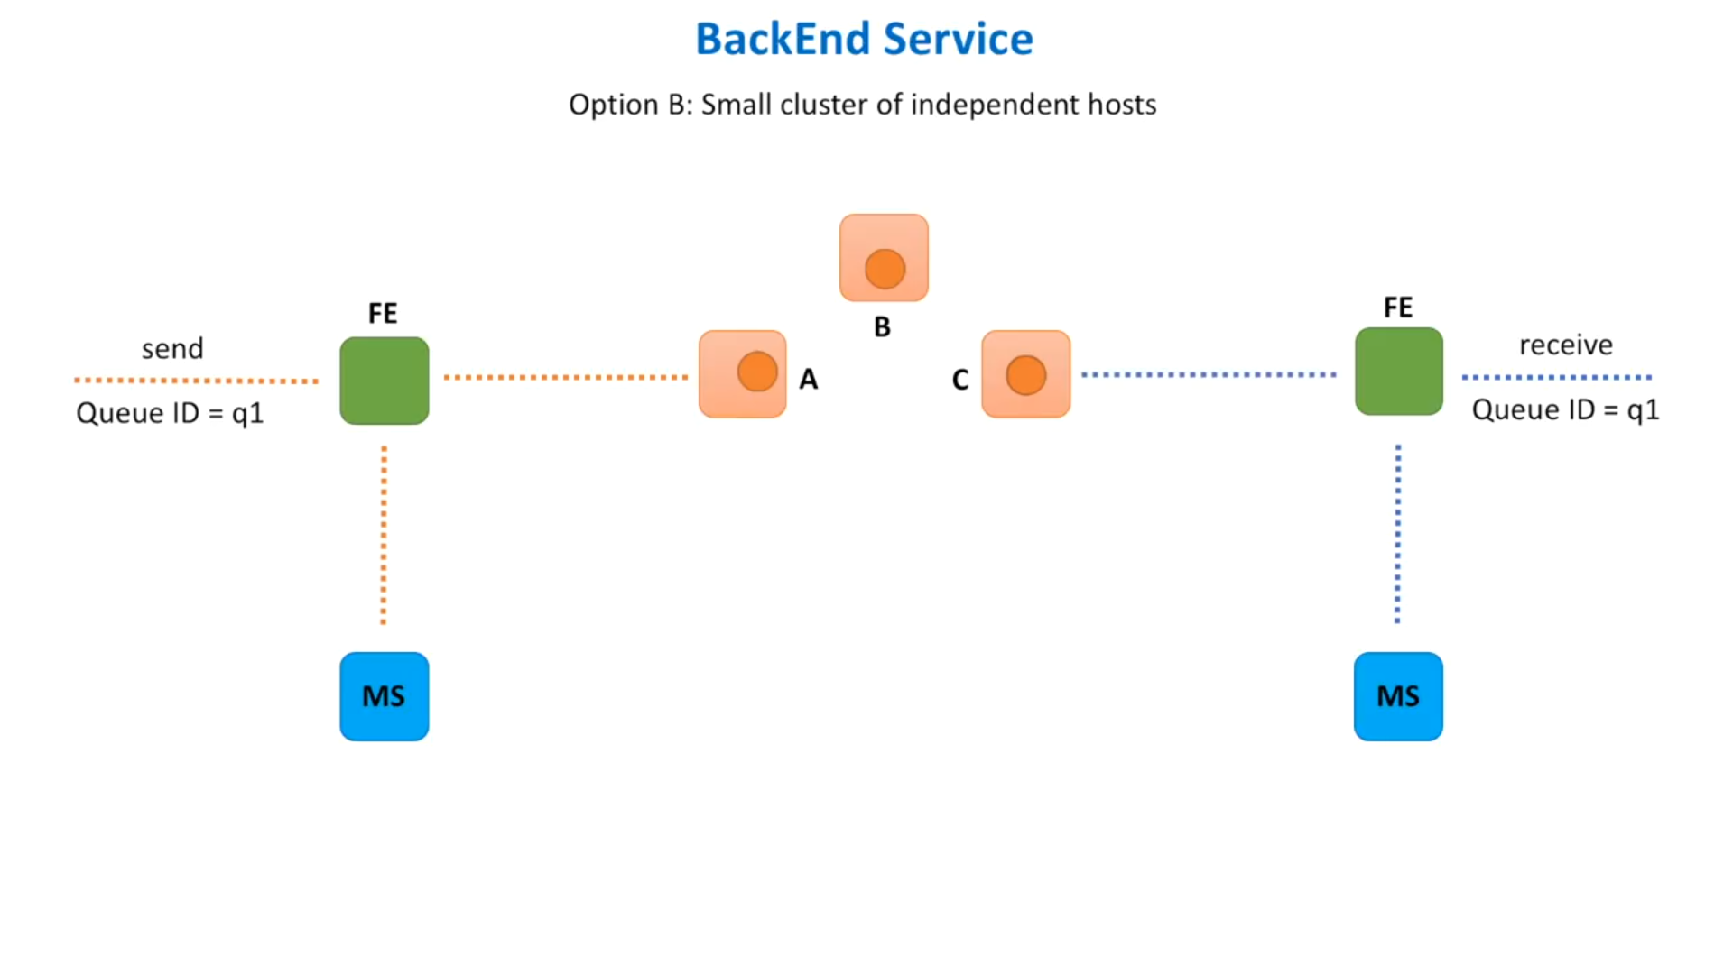
1. Message comes to FS. It consults MS to find the which cluster stores the data for this Queue_id.
2. FS selects a random node in this cluster as a leader. In this case A.
3. Read Request comes to FS. It again consults MS and selects a random node. In this case C. C becomes the leader and releases the data and is responsible to clean up the data from the replicas.

Slide 24
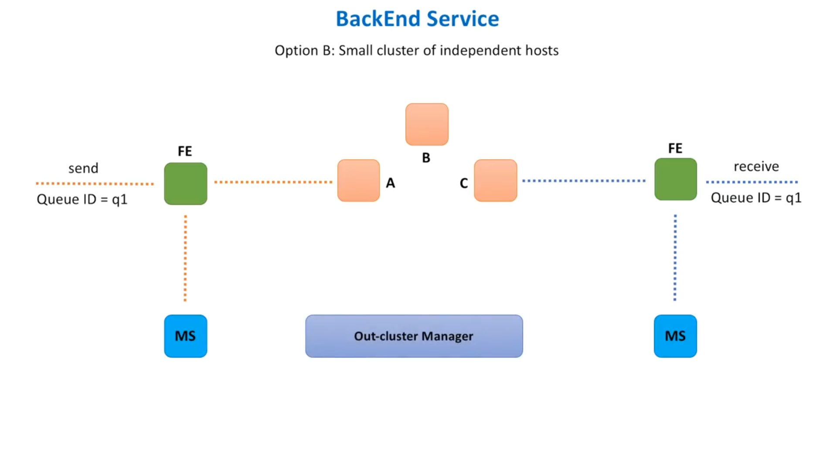
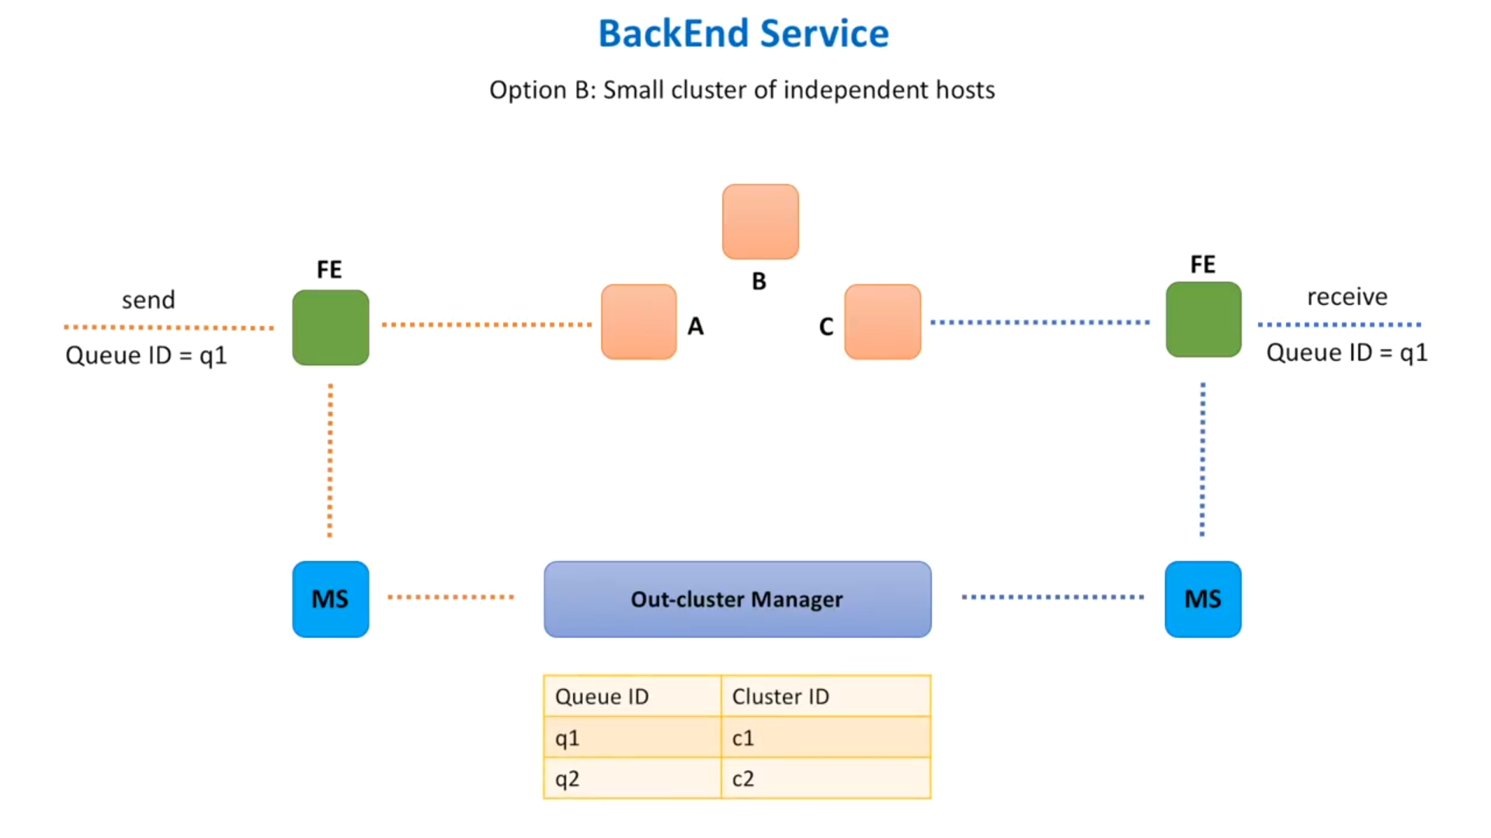

Slide 25
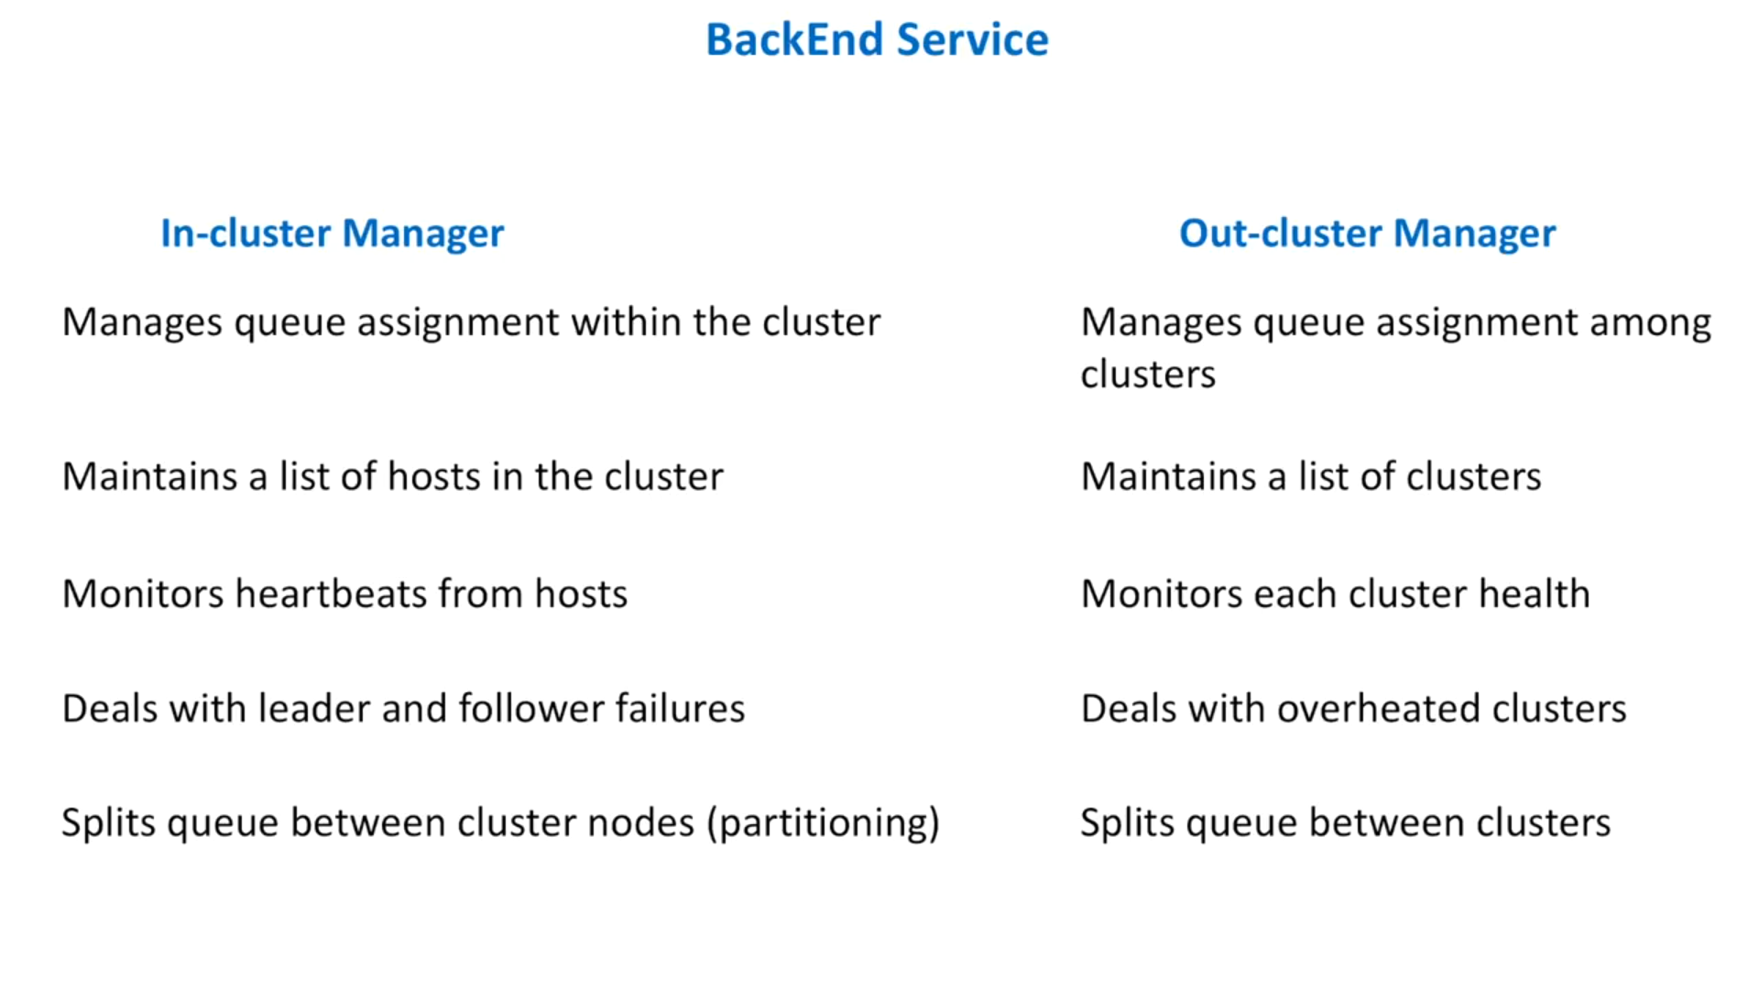

Slide 26
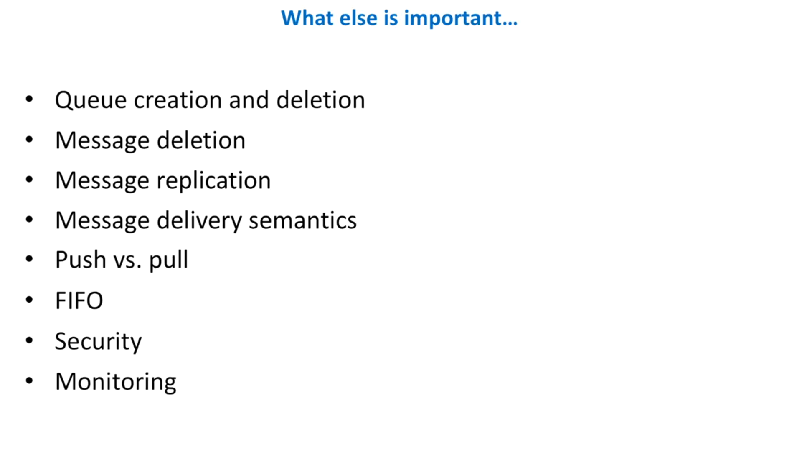

Slide 27
Queue Creation and Deletion
Queue creation has 2 options -
1. Create the queue automatically when the request for a message comes to Frontend service.
2. Expose and API for queue creation. API is a better option as we have control over queue creation parameters.
Queue deletion - a bit controversial. expose console access to admins for deletion.
Message Deletion - 2 options
Option 1 - Donot delete the message once delivered. The consumer is responsible for deletion.
Option 2 - Donot delete the message once delivered. Mark them as invisible. Run a periodic job to delete invisible messages.
Message Replication -
Synchronous replication : guarantees high durability and less latency.
Asynchronous replication : less durability and high latency.

Slide 28
Queue Creation and Deletion
Queue creation has 2 options -
1. Create the queue automatically when the request for a message comes to Frontend service.
2. Expose and API for queue creation. API is a better option as we have control over queue creation parameters.
Queue deletion - a bit controversial. expose console access to admins for deletion.
Message Deletion - 2 options
Option 1 - Donot delete the message once delivered. The consumer is responsible for deletion.
Option 2 - Donot delete the message once delivered. Mark them as invisible. Run a periodic job to delete invisible messages.
Message Replication -
Synchronous replication : guarantees high durability and less latency.
Asynchronous replication : less durability and high latency.

Slide 29
Push vs Pull
Pull model - Consumer constantly sends retrive message request to our broker. When a messsage is available then it is sent to the consumer.
Push model - Consumer doesnot constantly bombard the broker with retrieve calls. Instead conumer is notified as soon as a new message has arraived to the queue.
From the perspective pull is easier to implement. But from a consumer perspective, push is more convinient and it requires heavier implementation as we also need to maintain which consumer wants to listen to which queue.
FIFO - We cannot guarantee the order in which the messages will be stored and consumed.
Security - Encryption like SSL over HTTP helps to protect message in transit
Monitoring - We need to monitor the microservices that we build. Each service that we build, has to emit data.

Slide 30
Message Delivery Semantics-
Message Delivery Semantics means how many times the producer will retry in case of error or lost ack.
1. At least once semantics: if the producer receives an acknowledgement (ack) from the broker and acks=all, it means that the message has been written exactly once to the queues. However, if a producer ack times out or receives an error, it might retry sending the message assuming that the message was not written to the queue. If the broker had failed right before it sent the ack but after the message was successfully written to the queue, this retry leads to the message being written twice and hence delivered more than once to the end consumer. And everybody loves a cheerful giver, but this approach can lead to duplicated work and incorrect results.

Slide 31
At most once semantics: if the producer does not retry when an ack times out or returns an error, then the message might end up not being written to the queue, and hence not delivered to the consumer. In most cases it will be, but in order to avoid the possibility of duplication, we accept that sometimes messages will not get through.
Exactly once semantics: even if a producer retries sending a message, it leads to the message being delivered exactly once to the end consumer. Exactly-once semantics is the most desirable guarantee, but also a poorly understood one. This is because it requires a cooperation between the messaging system itself and the application producing and consuming the messages. For instance, if after consuming a message successfully you rewind your consumer to a previous offset, you will receive all the messages from that offset to the latest one, all over again. This shows why the messaging system and the client application must cooperate to make exactly-once semantics happen.

